Slide 1

PROJECT TITLE -SEASONAL AGRICULTURE PERFORMANCE ANALYSIS
PRESENTED BY:
NAME: SPOORTHI H RAO
COLLEGE NAME : SAHYADRI COLLEGE OF ENGINEERING AND MANAGEMENT
AICTE STU ID : STU6a172b078bfc31779903239

Slide 2

PROBLEM STATEMENT
Agricultural activities are influenced by seasonal variations in environmental conditions, farming practices, resource availability and market conditions. As a result, agricultural performance may differ from one season to another.
However, raw agricultural data does not clearly explain how agricultural performance changes across seasons or what patterns can be observed in different seasonal conditions.
The problem is to analyze the given agricultural dataset and investigate seasonal differences in agricultural performance by identifying meaningful patterns, trends, relationships and variations within the available data.

Slide 3
PROJECT DESCRIPTION
The project focuses on analyzing agricultural performance across different seasons using data analysis and visualization techniques.
The dataset was analyzed to understand variations in:
Crop yield and production
Profitability and revenue
Rainfall and temperature
Irrigation methods
Water usage and efficiency
Crop performance across seasons
Disease and pest risk
Analysis Process
Data Collection → Data Cleaning → Exploratory Analysis → Visualization → Seasonal Comparison → Insights → Recommendations

Slide 4

WHO ARE THE END USERS?
👨‍🌾 Farmers
Support seasonal crop planning
Help compare crop and irrigation performance
Encourage efficient water usage
🏛️ Government & Agricultural Departments
Support data-driven agricultural planning
Identify seasonal production and profitability patterns
📊 Agricultural Analysts & Researchers
Study relationships between environmental and agricultural variables
Support further agricultural research
💼 Agribusiness & Resource Managers
Understand production and profitability patterns
Support operational decision-making

Slide 5








TECHNOLOGY USED
Data loading, cleaning
and manipulation
Numerical operations and
statistical calculations
Data analysis and implementation
Data Visualization
Statistical and advanced
visualization
Development and analysis
environment
Project code and version control

Slide 6
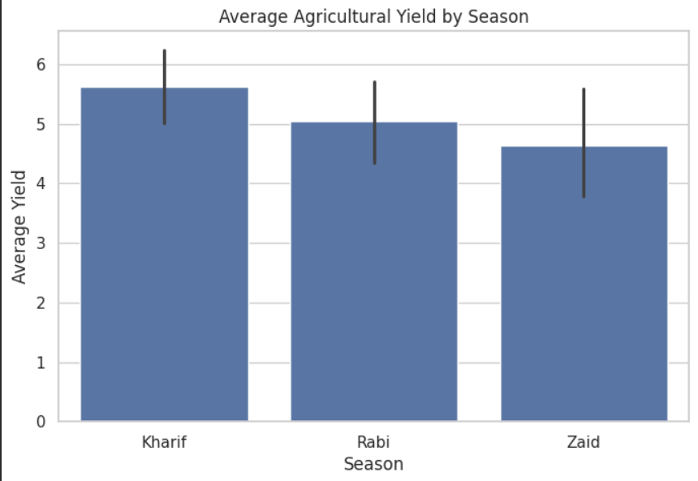
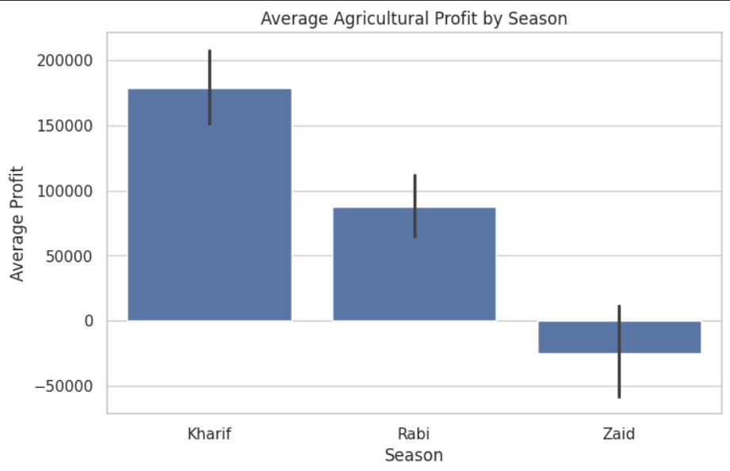
RESULTS
SEASONAL PERFORMANCE
Kharif recorded the highest average yield of 5.63 tonnes/hectare.
Kharif also recorded the highest average profit of ₹1,78,914.65 per farm.
Zaid had the lowest average yield of 4.64 tonnes/hectare.
Zaid recorded a negative average profit of ₹24,804.82 per farm, indicating that average costs exceeded average revenue.

Slide 7
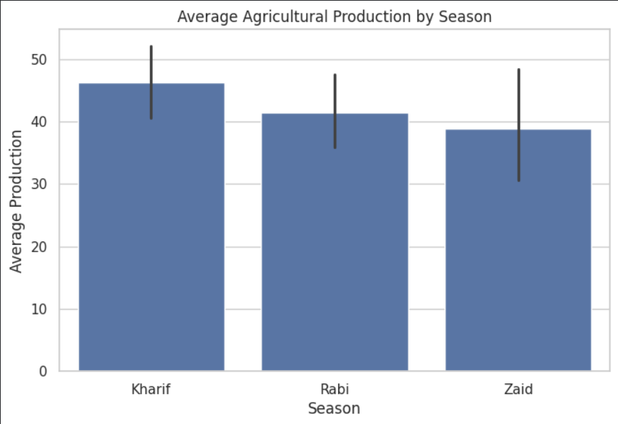
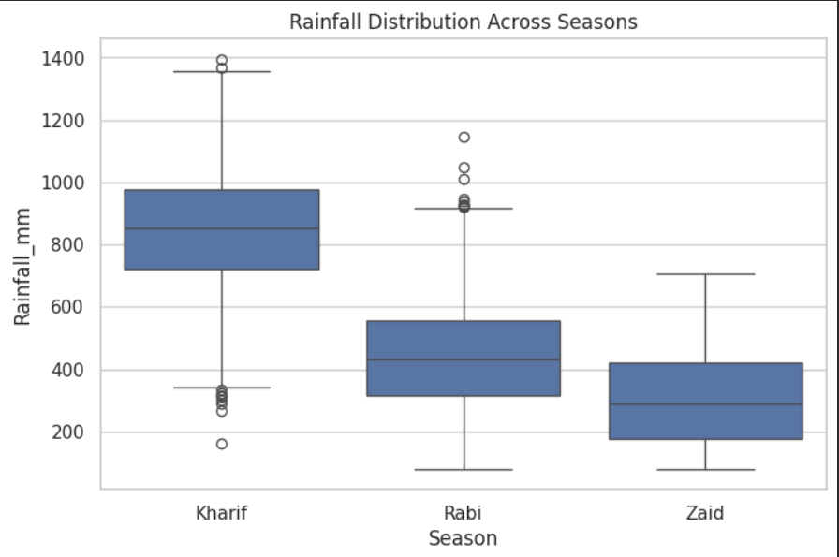
RESULTS
AGRICULTURAL PERFORMANCE
Kharif recorded the highest average production at 46.31 tonnes per farm.
Rabi recorded an average production of 41.49 tonnes per farm.
Zaid recorded the lowest average production at 38.89 tonnes per farm.
Rainfall distribution varied across seasons providing environmental context for seasonal agricultural performance.

Slide 8
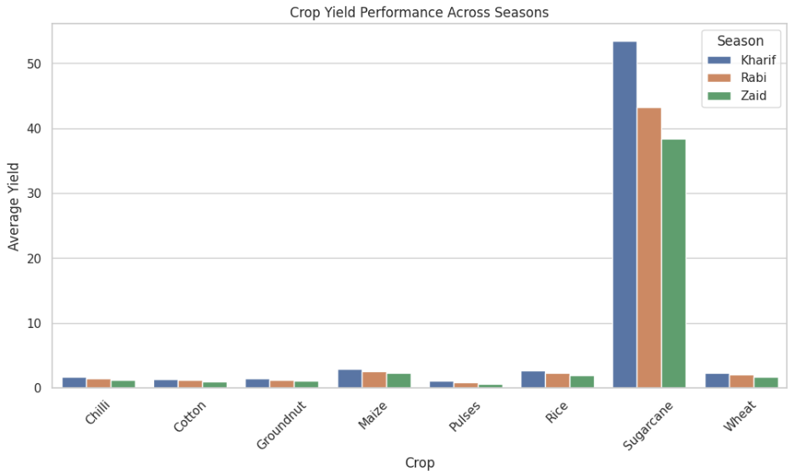
RESULTS
CROP PERFORMANCE ACROSS SEASONS
Analysis
Crop performance varied considerably across seasons.
Sugarcane recorded the highest observed average yield of 53.46 tonnes/hectare during Kharif.
Pulses showed the lowest average yield across the seasons.
The results highlight the importance of matching crop selection with seasonal conditions.
Key Insight:
Season-specific crop selection can help improve agricultural productivity.

Slide 9
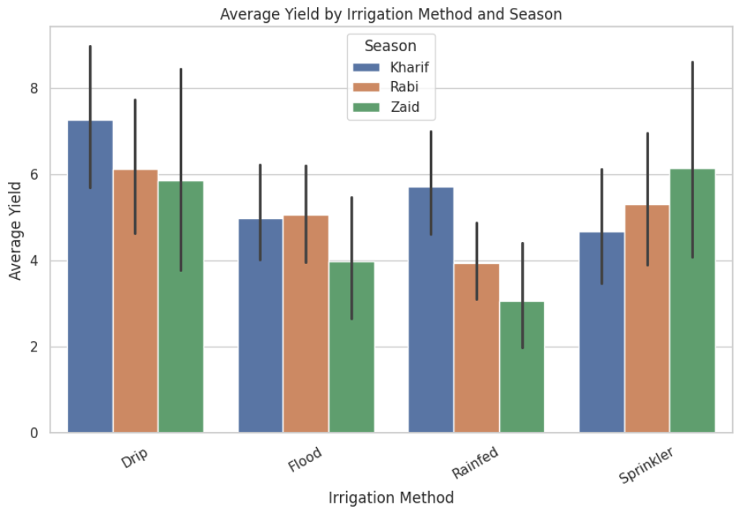
RESULTS
IRRIGATION METHOD VS YIELD
Analysis
Drip irrigation recorded the highest average yield at 6.62 t/ha, followed by Sprinkler (5.19 t/ha), Flood (4.90 t/ha), and Rainfed (4.61 t/ha).
The results show noticeable differences in yield across irrigation methods.
Drip irrigation was associated with better yield performance in the dataset.
Key Insight:
Efficient irrigation methods were associated with higher agricultural yield.

Slide 10
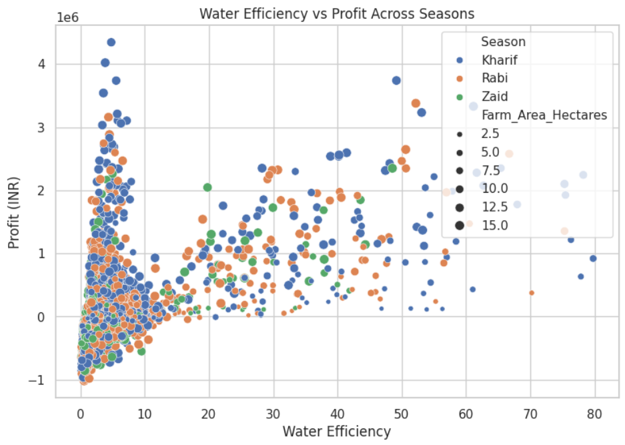
RESULTS
WATER EFFICIENCY VS PROFIT
Analysis
Water efficiency showed a moderate positive correlation with profit(r = 0.489).
Farms with higher water efficiency generally tended to achieve higher profitability.
This highlights the importance of efficient water management in agricultural operations.
Key Insight:
Better water efficiency was associated with higher farm profitability.

Slide 11
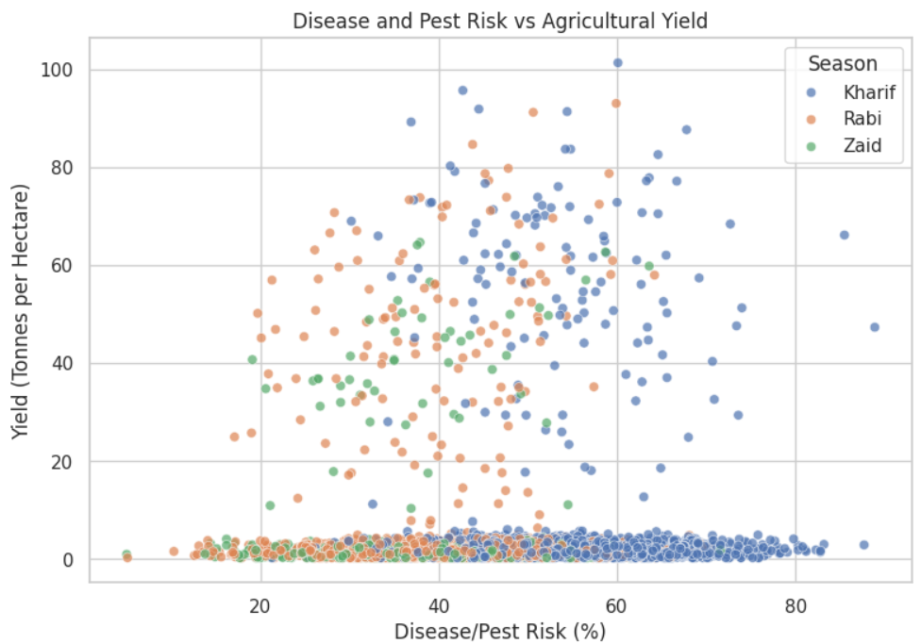
RESULTS
DISEASE/PEST RISK VS YIELD
Analysis
Disease and pest risk showed an almost negligible linear correlation with yield (r = 0.013).
Risk variation alone did not show a significant relationship with crop yield in the dataset.
Other factors may have a greater influence on agricultural yield.
Key Insight:
Disease/pest risk alone showed limited linear association with agricultural yield.

Slide 12
FUTURE SCOPE
The project can be extended beyond exploratory analysis to develop a more comprehensive agricultural decision-support system.
Predictive Modeling: Develop machine learning models to predict crop yield and profitability.
Weather Integration: Incorporate real-time rainfall, temperature, humidity, and climate data.
Soil Analysis: Include soil quality, moisture, nutrient, and soil-type information.
Crop Recommendation: Develop a system to recommend suitable crops based on season, soil, weather, and resource availability.
Future development can transform the current analytical study into a data-driven agricultural decision-support solution.

Slide 13
GITHUB LINK
View the project here:
Seasonal-Agriculture-Performance-Analysis
https://github.com/Spoorthi-rao/Seasonal-Agriculture-Performance-Analysis

Slide 14
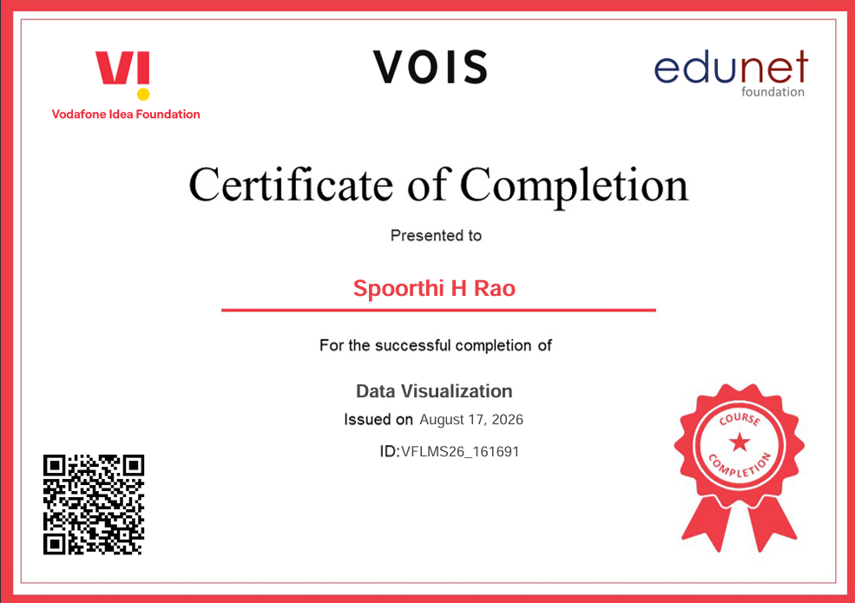
VOIS COURSE COMPLETION CERTIFICATE - COURSE NAME- DATA VISUALIZATION

Slide 15
THANK YOU
.
.

